Slide 1
CE889 – Lunar Lander Neural Network Project
Muhammed Baris govercin
2501385

Slide 2
Partition of data
processing of data
Min–Max Normalization used
Why preprocessing was necessary?
Ensures the sigmoid activation works effectively
Provides stable weight updates during training
Prevents large raw values from destabilising learning
How to handle with feature selection
Only X_target and Y_target were used, as required by the assignment
All other collected features were ignored
Output handling
Outputs (velocities) were not normalized, since a linear output layer does not require scaling
70% Training
15% Validation
15% Test
trainTestValSplit() function shuffles and splits the data

Slide 3
Data Cleaning & Min–Max Normalisation
cleanConvertCsv()
Skips empty lines.
Skips if column number is less than 4
Skip if any one of the column is empty
Converts x, y, vy, vx to float. Skips if cannot do it.
normaliseValue()
Normalise x_target and y_target to [0-1]
Outputs new_vel_y and new_vel_x remain original.
Because velocity outputs are physical values, they remain at the original scale. Normalizing them would twist the actual motion.

Slide 4
Backpropagation MLP Architecture
Inputs (2): x_target_norm, y_target_norm
Hidden Layer: 3 neurons, Sigmoid activation
Outputs (2): new_vel_x, new_vel_y (Linear)
Overall Topology: 2 → 3 → 2

Slide 5
Design Choices & Model Size
randNumGenerator()
Returns a number between [0,1) for initializing weights randomly.
More hidden layer neurons might improve accuracy but require more computation and risk overfitting.
Sigmoid works well with normalized inputs in [0, 1]. Tanh requires [-1, 1] (might be used with Z-score)

Slide 6
Training procedure & hyperparameters
Hyperparameters:
Input Size: 2
Hidden Size: 3
Output Size: 2
Learning Rate: 0.01
Momentum: 0.6
Epochs: 111
Training loop with custom shuffling and MSE calculation.
Increasing Hidden Size
+ The model can learn more patterns and may get lower MSE. – It may overfit and needs more computation.
Increasing Learning Rate
+ The model learns faster. – Training can become unstable and the error may increase suddenly.
Increasing Momentum
+ Weight updates become smoother and faster. – Too much momentum can cause the model to move too far (overshoot).
Increasing Epochs
+ The model trains for a longer time and may improve. – It can overfit, and extra epochs may not give much benefit.

Slide 7
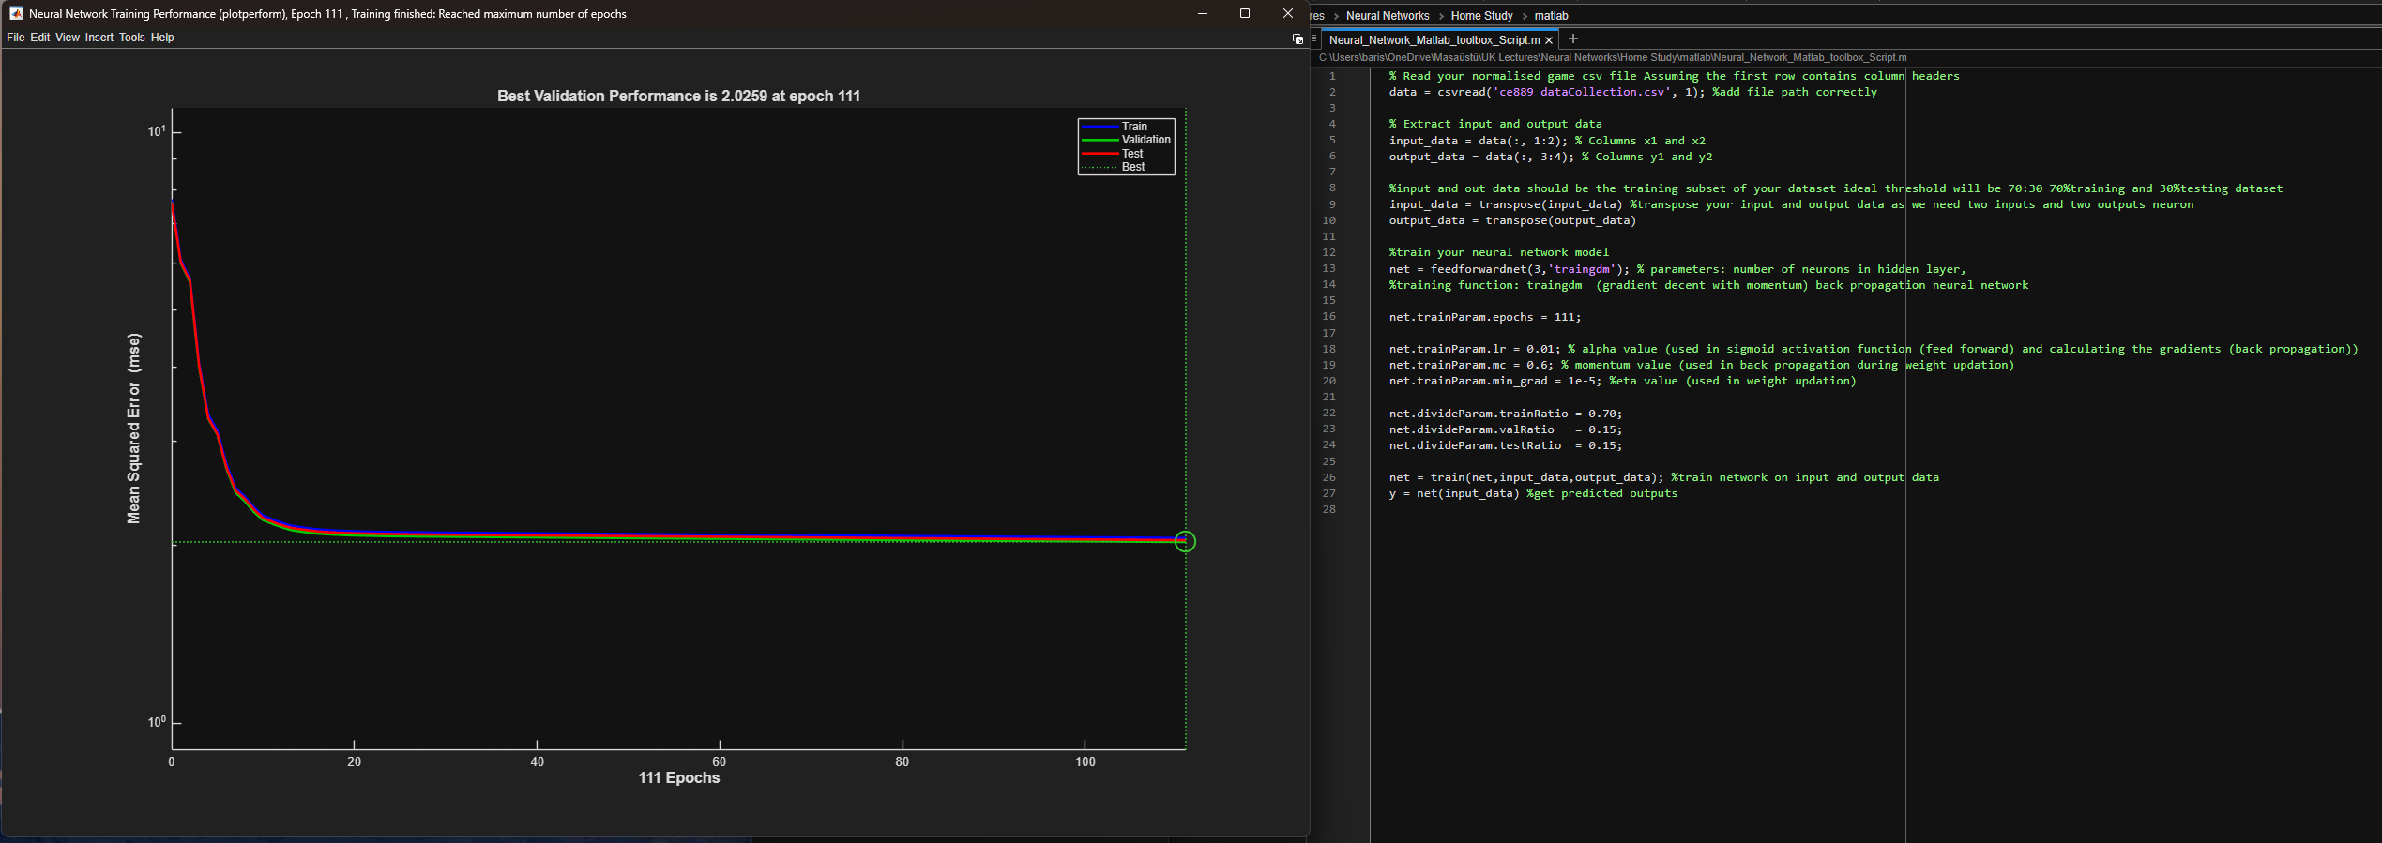
mse curve & stopping criteria

Slide 8
Extra information
Code is divided into three parts for modularity
Firstly Normalisation.py should be started which creates scaler.py
Then TrainNetwork.py which creates weights.py
Lastly NeuralNetHolder.py

